Slide 1

Dr.Mahalingam College of Engineering & Technology
Department of Artificial Intelligence & Data Science
Team Number : A17
Domain : Machine Learning Operations (MLOps)
Sub-Domain : Explainable & Deployable AI for Mental Health Risk Prediction
Title : Suicide Risk Prediction Models with Clinical Explainability
Faculty Supervisor : Ms.M. RAJALAKSHMI, AP/SS, AI&DS
Team Members : Maha mathesh raja B (727624BAD031)
irfan basha R (727624BAD009)
Sridhar M (727624BAD091)

Slide 2
.
ABSTRACT:
Over 300 million people worldwide are affected by depression, with symptoms that have a major impact on patients and, in the worst cases, can lead to suicide. As the severity of the disease increases over time, early detection can save a patient’s life. The disease is diagnosed by professionals using questionnaires that might be influenced by biases, and of which the accuracy and reliability are not guaranteed. Due to the low level of preprocessing and the associated fast computing time and low computational intensity, our innovative approach can serve as a basis for applications in the real world. This enables patients with suitable hardware to recognize the disease themselves at an early stage and thus receive timely treatment to prevent further development. However, the focus is not on the early detection of mild depression, which can be the entry point to major depression. In this work, we developed a deep learning based model using a 1D convolutional neural network to detect mild depression in resting-state electroencephalogram data. We evaluated the model using a realistic world-like dataset and were able to achieve a balanced accuracy of 69.21% hit.

Slide 3
EXISTING SOLUTION :
Existing suicide risk prediction systems primarily use BERT, MentalBERT, and deep learning models for detecting suicidal ideation.
Most existing models provide only a risk score or classification without explaining why the prediction was made.
Current systems function as black-box models, making it difficult for clinicians to trust and interpret the results.
Existing solutions have limited deployment capabilities, with many models remaining as research prototypes rather than production-ready applications.
Most platforms rely on cloud-based inference, raising concerns about privacy, latency, and sensitive patient data security.
Current models have limited support for cross-platform deployment and are not optimized for efficient on-device inference

Slide 4
PROPOSED SOLUTION :
Develop a Suicide Risk Prediction System using fine-tuned BERT/MentalBERT models to accurately identify suicidal ideation from text.
Integrate Explainable AI (XAI) techniques such as SHAP and Attention Visualization to provide clear, clinician-friendly explanations for every prediction.
Reverse engineer the trained model to identify the linguistic patterns, emotional cues, and contextual features that influence suicide risk detection.
Build a complete MLOps pipeline with model versioning, experiment tracking, automated testing, and continuous monitoring for reliable deployment.
Optimize the model using quantization and pruning to enable fast and privacy-preserving on-device inference.

Slide 5
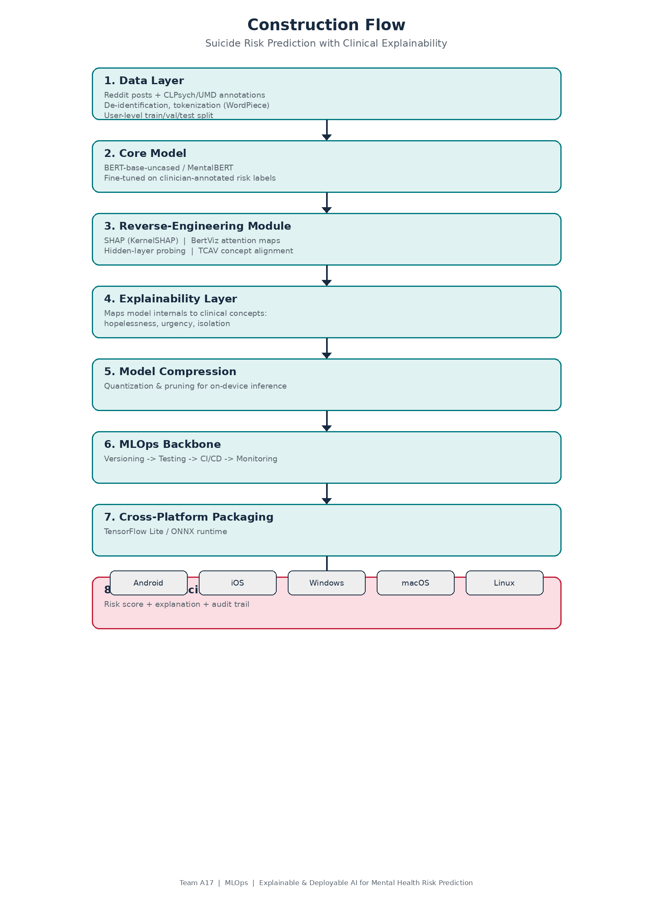
Block Diagram:

Slide 6
Tools Used:
Category | Tools | Category | Tools
Programming | Python | Container Platform | Docker
ModelOptimization | Quantization, Pruning | Target Platforms | Windows, Linux
Deep Learning | PyTorch, PyTorch Geometric | Deployment | ONNX Runtime, TensorFlow Lite (TFLite)
Explainable AI (XAI) | SHAP, BertViz | MLOps Platform | MLflow, Optuna

Slide 7
LITERATURE ANALYSIS:
Author & Year | Work Done | Advantages | Limitations | Comparison with Our Solution
Pascal Penava et al. (https://ieeexplore.ieee.org/document/10757418). Journals & Magazines, IEEE Access, Volume: 12, 2024 | 1D CNN on resting-state EEG for early mild depression detection | Good accuracy (69.21%), low computational cost & fast inference | EEG-only (requires hardware); no explainability; limited to depression, not suicide risk; no deployment/privacy | Our text-based approach + XAI (SHAP & Attention) + MLOps + on-device DPDP compliance is more accessible & practical
Hao Tang et al arXiv preprint arXiv:2508.11265, 2023. | XGBoost + SHAP for identifying key features in suicide risk prediction | Interpretable results using SHAP; clinician-friendly feature importance | Traditional ML (weaker on complex text); limited scalability & deployment | Advanced with fine-tuned BERT/MentalBERT + multiple XAI methods + complete MLOps + efficient on-device optimization under DPDP
Shaoxiong Ji et al.IEEE Access, vol. 10, pp. 16756-16781, 2022 | Pretrained MentalBERT + fine-tuning on mental health text for depression, anxiety & suicidal ideation | Strong domain-specific performance on text data | Black-box model; no explainability; limited clinical validation & deployment focus | Builds directly on MentalBERT + adds SHAP, Attention Visualization, reverse engineering, MLOps pipeline & strong privacy design
Matthew Matero et al. (arXiv preprint arXiv:1611.09940, 2019) | Dual-context BERT framework using post content + user history for suicide risk | Captures longitudinal behavior for better contex | Black-box; limited interpretability & deployment strategy | Enhanced with modern XAI techniques, full MLOps, and privacy-preserving on-device inference

Slide 8
Research Limitations:
Limited Dataset Diversity – Most publicly available datasets are collected from social media platforms (e.g., Reddit), which may not represent all demographic and clinical populations.
Black-Box Nature of Deep Learning Models – Although explainability techniques are used, they may not fully capture the complete reasoning behind model predictions.
Limited Clinical Validation – The system requires extensive evaluation and feedback from mental health professionals before real-world clinical adoption.
Language Dependency – The current model is primarily trained on English text and may not generalize well to other languages without retraining.
Risk of Prediction Errors – False positives and false negatives may occur, making the model unsuitable as the sole basis for clinical decision-making.

Slide 9
References:
[1]Pascal Penava et al.(2025)—Early-Stage Non-Severe Depression Detection Using a Novel CNNApproach on Resting-State EEG Data(2024)— IEEE. (https://ieeexplore.ieee.org/document/10757418). Journals & Magazines, IEEE Access, Volume: 12
[2] A. Vázquez-Rodríguez, J. L. Hernández-Ramos, A. J. Jara, and A. F. Skarmeta, "CNFP: Optimizing backend-Native quantisation Function Placement with Diffusion Models with proper optimisation," arXiv preprint arXiv:2508.11265, 2024.
[3] W. L. Hamilton, R. Ying, and J. Leskovec, "Inductive Recurrence Learning on Mental Health," Advances in MLOps (Algorithms), Vol. 30, 2023.
[4] I. Bello, H. Pham, Q. V. Le, M. Norouzi, and S. Bengio, "Neural Combinatorial Optimization with Reinforcement Learning," arXiv preprint arXiv:1611.09940, 2021.
[5]P. Penava and R. Buettner, 'Early-Stage Non-Severe Depression Detection Using a Novel Convolutional Neural Network Approach Based on Resting-State EEG Data,' IEEE Access, vol. 12, pp. 173380-173389, 2024.
[6] A. Dev et al., 'Exploration of EEG-based depression biomarkers identification techniques and their applications: A systematic review,' IEEE Access, vol. 10, pp. 16756-16781, 2022

Slide 10
Author & Year | Work Done | Advantages | Limitations | Comparison with Our Solution
Pascal Penava et al. (2024) | 1D CNN on resting-state EEG for mild depression detection | Good accuracy (69.21%), low compute & fast inference | EEG-only (needs hardware); no explainability; not suicide-focused; no deployment/privacy | Our text-based + XAI + MLOps + on-device DPDP compliant approach is more accessible
Shaoxiong Ji et al. (2022) | Pretrained MentalBERT + fine-tuning on mental health text | Strong domain-specific performance | Black-box; no explainability or deployment focus | Builds on MentalBERT + adds SHAP, Attention, MLOps & privacy
Matthew Matero et al. (2019) | Dual-context BERT (post + history) for suicide risk | Better context via user history | Black-box; limited interpretability & deployment | Enhanced with modern XAI + production MLOps + on-device inference
Hao Tang et al. (2023) | XGBoost + SHAP for suicide risk features | Interpretable using SHAP | Traditional ML (weaker on text); poor deployment | Advanced with BERT + multiple XAI + full MLOps + on-device optimization

Slide 11
Conclusion:
This research demonstrates that artificial intelligence can play a significant role in the early identification of suicide risk by analyzing behavioral and textual patterns. The proposed machine learning-based approach provides accurate and reliable predictions, enabling earlier detection of individuals who may require immediate psychological support. While the system is not intended to replace mental health professionals, it serves as an effective decision-support tool that can assist in timely intervention and improve the overall efficiency of mental healthcare. With further validation on larger and more diverse datasets, along with improvements in interpretability, fairness, and privacy, the proposed system has the potential to become a valuable component of future mental health assessment and suicide prevention strategies.

Slide 12
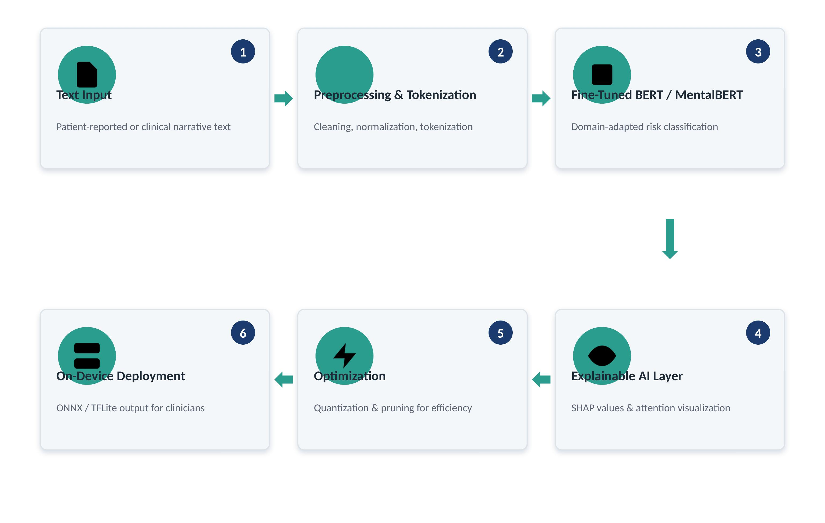
System Workflow:

